Slide 1
Income
Poverty Status
Education
The Labor Force
Journey To Work
Marital Status
Languages Spoken
Migration
Citizenship
Disability
Ancestry
Military Service
Housing Characteristics

Slide 2
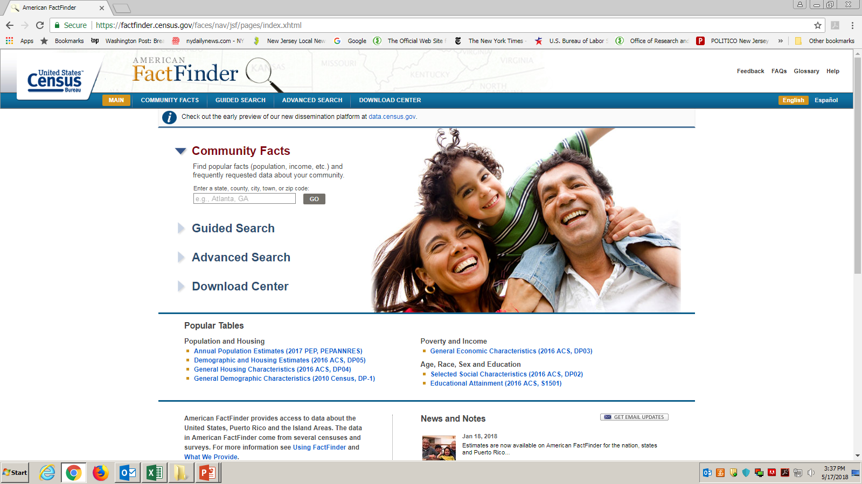

Slide 3
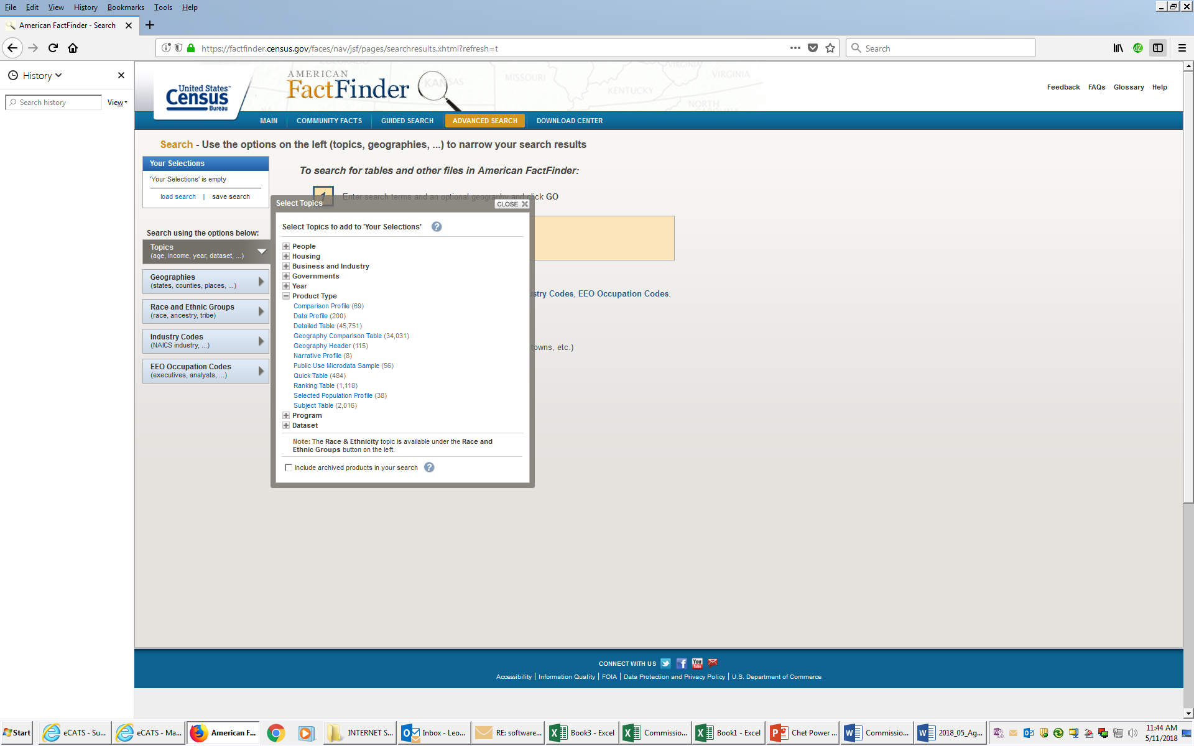
Accessing and Downloading PUMS Data from American Factfinder

Slide 4
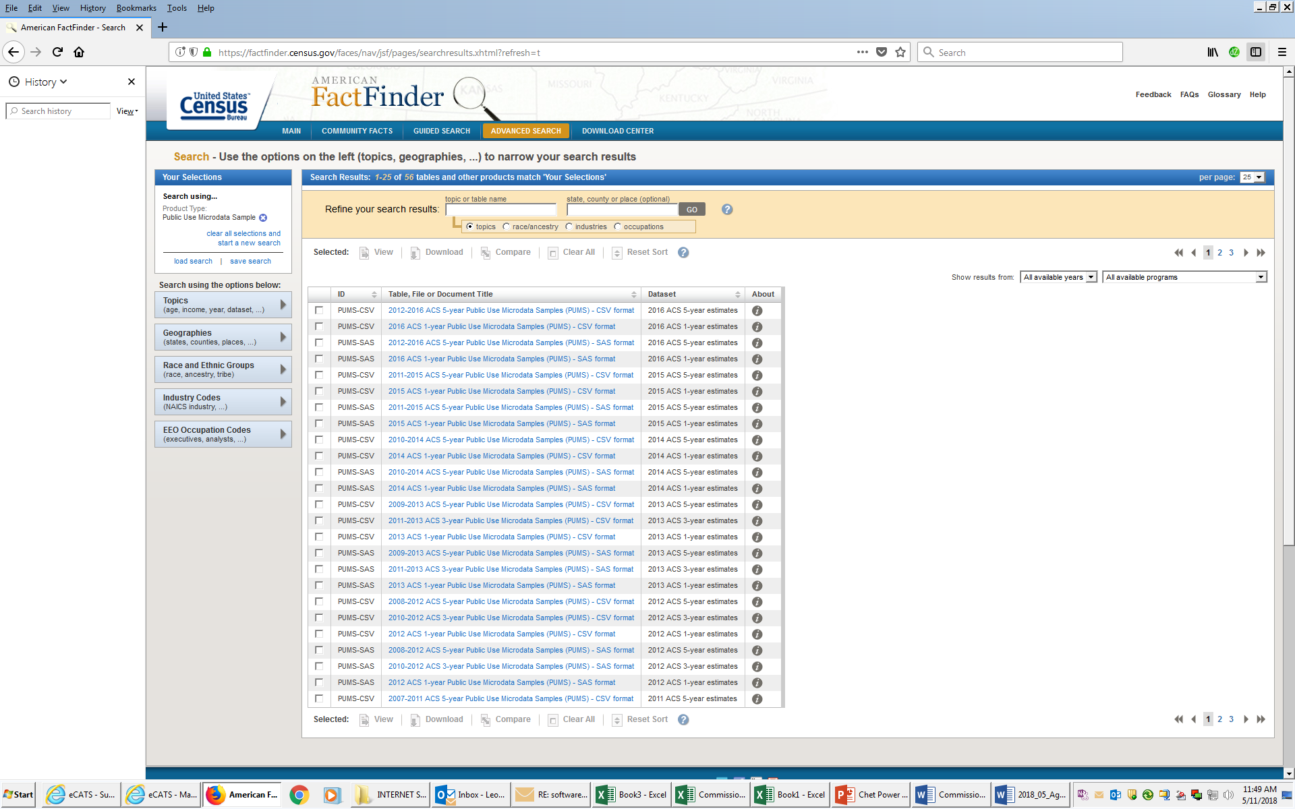
Accessing and Downloading PUMS Data from American Factfinder
Notes:
Pums Files are available in CSV and SAS Formats. Select the year and format you wish to download.

Slide 5
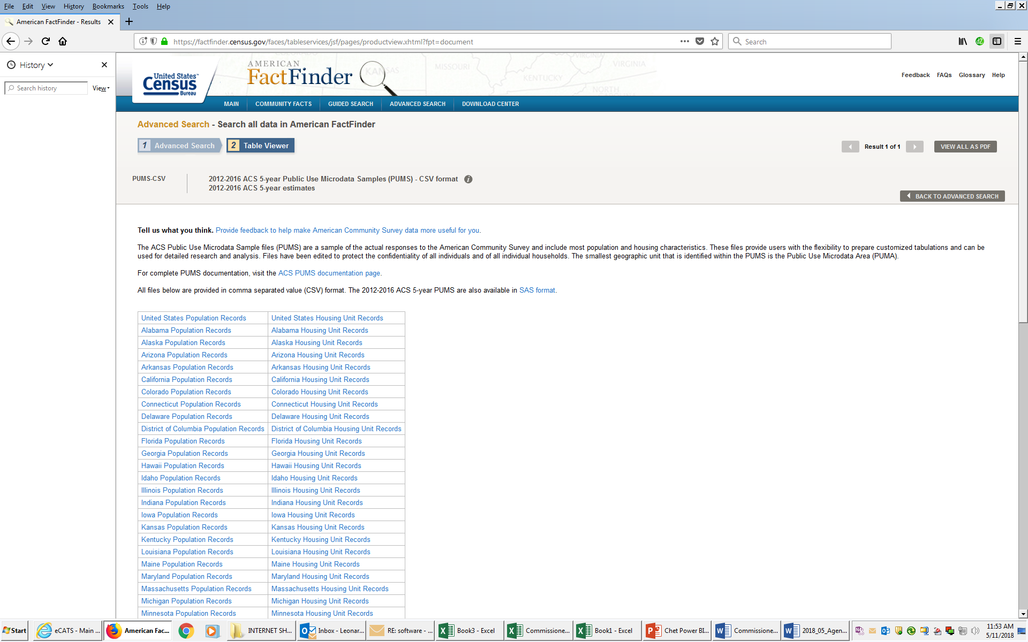
Accessing and Downloading PUMS Data from American Factfinder
Notes:
From here you select your state and type of records (Population or Housing Unit) and download the compressed .zip file to your computer.

Slide 6
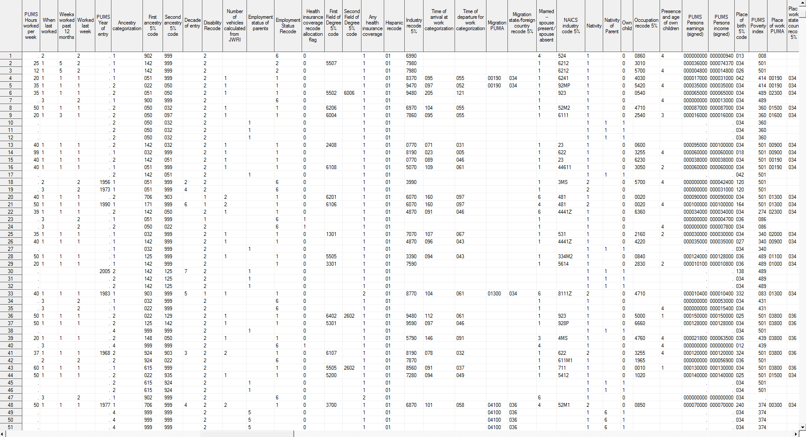
Unprocessed Public Use Microdata Sample (PUMS)Data for New Jersey
Notes:
This is what unprocessed PUMS Data looks like. The PUMS data allows for cross tabulations of data not available in typical Census publication tables. There is a wealth of information here but the challenge is to extract data and produce analyses that are meaningful to the user. The goal here was to extract data that could be used to show characteristics of New Jersey’s key industry clusters.

Slide 7
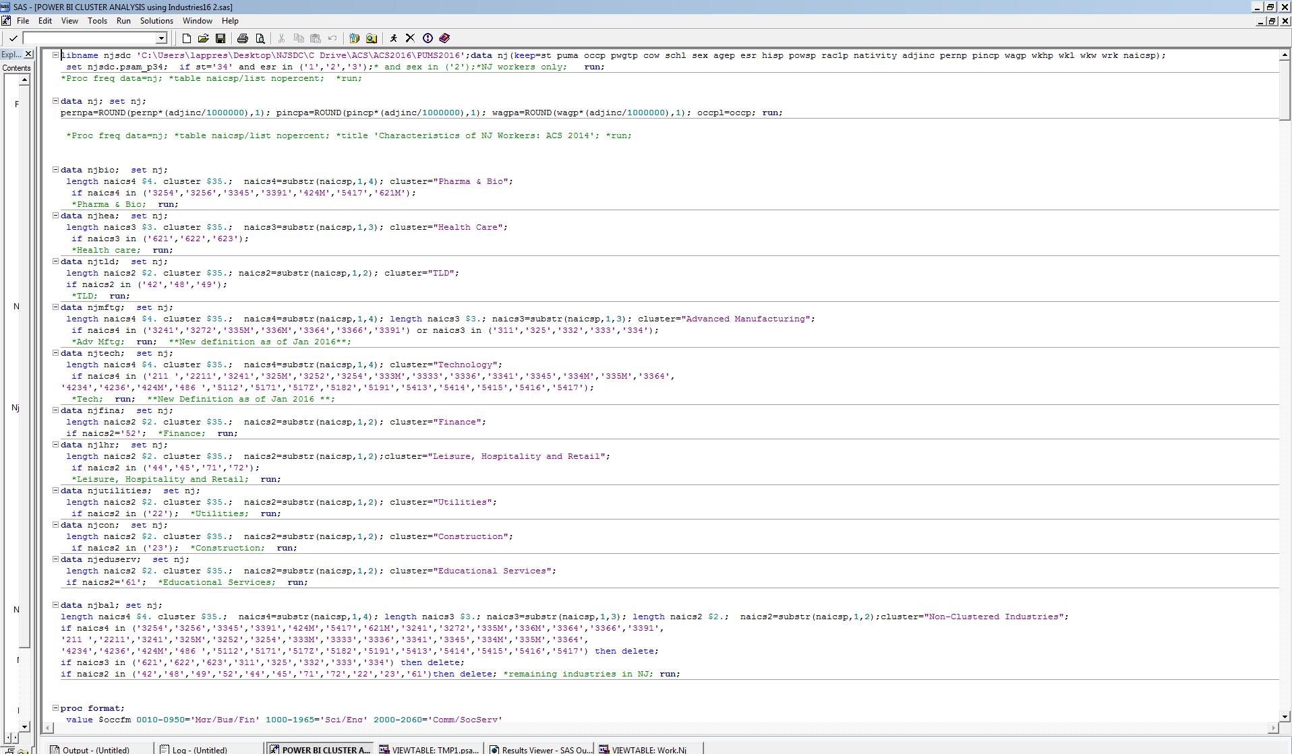
Using SAS to Reorganize, Aggregate and Rename (PUMS)Data
Notes:
Using a statistical analysis package like SAS we are able to focus on those variables that we are interested in (Industry, Occupation, Educational Attainment, Age, Race, Sex, Employment Status, Wages etc.) and aggregate them by NAICS code into our Industry Cluster Characteristics and rename coded data into readable information.

Slide 8
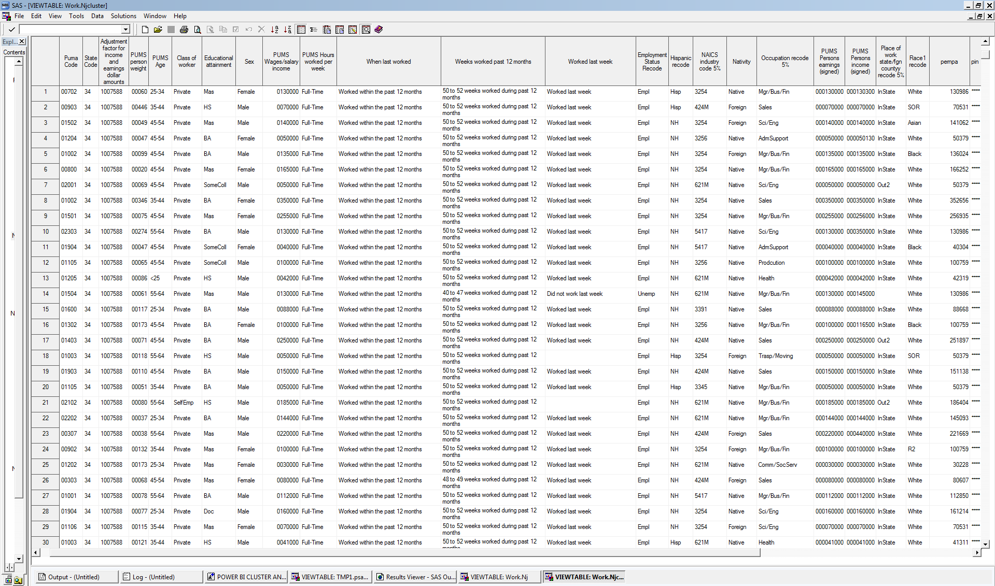
Post SAS Processing
Notes:
After running our SAS job the data is much easier to read. From here the data is imported into an Access Database.

Slide 9
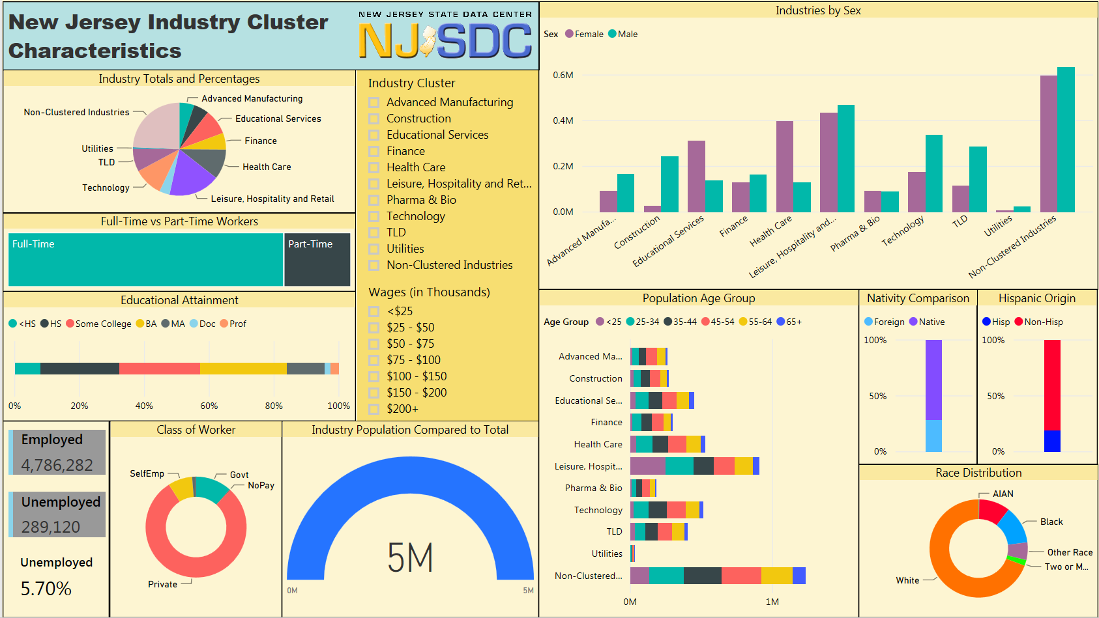
Notes:
This is what our finished dashboard looks like when published to the web. The user can rollover any of the charts to get the statistics that are visualized. Clicking on the Visuals allows you to do “What If” analysis on the fly in ways that are not possible through current tools used to query the PUMS data. The Filters in the center of the dashboard can be used to further refine your analysis.

Slide 10
NJ Clusters
https://app.powerbigov.us/view?r=eyJrIjoiYTdkYTEwNGUtMjQxMi00ZDgzLWJmNjItOWFmOGFjOTMwMTAzIiwidCI6IjUwNzZjM2QxLTM4MDItNGI5Zi1iMzZhLWUwYTQxYmQ2NDJhNyJ9
QCEW
https://app.powerbigov.us/view?r=eyJrIjoiYWIwMzllZTMtYTQyMy00M2NjLWFhOGEtZDY1NWQ2MDRlZjRhIiwidCI6IjUwNzZjM2QxLTM4MDItNGI5Zi1iMzZhLWUwYTQxYmQ2NDJhNyJ9

