Slide 1
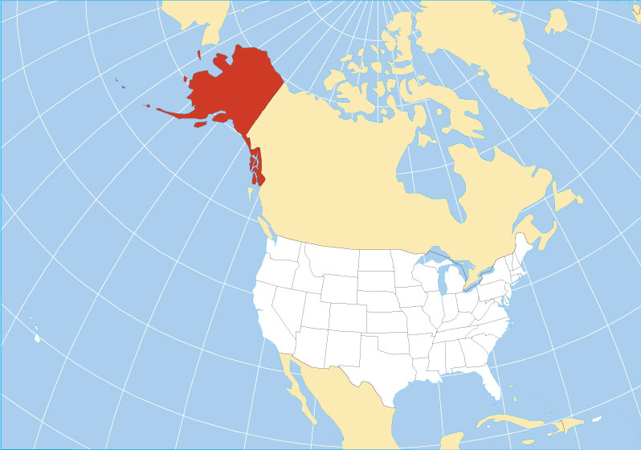
Alaska’s Enhanced Wage Records
National LMI Directors’ Conference, State Day
May 22, 2018
Dan Robinson
Research Chief
Alaska Dep’t of Labor
and Workforce Develop.

Slide 2

Inigo Montoya’s second most famous line?
Notes:
Keep in mind that oil and gas jobs pay an average of around $120,000 a year so those losses alone equate to about $3.5 billion gone from our economy. On the other hand, somewhere around 30 percent of oil and gas workers are nonresidents and to the extent they were fly-in, fly-out workers to the North Slope, not much of those salaries were being spent in Alaska in the first place.

Slide 3
Going back to the beginning …
In the 1980s Alaska wanted to be able to justify “Alaska hire” preferences for state construction projects; that led to adding occupational data and worksite data to our wage records.
Notes:
Keep in mind that oil and gas jobs pay an average of around $120,000 a year so those losses alone equate to about $3.5 billion gone from our economy. On the other hand, somewhere around 30 percent of oil and gas workers are nonresidents and to the extent they were fly-in, fly-out workers to the North Slope, not much of those salaries were being spent in Alaska in the first place.

Slide 4
Was it a big deal?
There’s no indication in the historical record or from people who were involved at the time that employers noisily objected or that the IT challenges were especially complicated, etc.
Notes:
Keep in mind that oil and gas jobs pay an average of around $120,000 a year so those losses alone equate to about $3.5 billion gone from our economy. On the other hand, somewhere around 30 percent of oil and gas workers are nonresidents and to the extent they were fly-in, fly-out workers to the North Slope, not much of those salaries were being spent in Alaska in the first place.

Slide 5
It’s not easy data to manage
Employers don’t think in SOC (consider the difference between wages as a reported field and a SOC code) and they don’t necessarily remember how they categorized their workers last year or even last quarter.
Notes:
Keep in mind that oil and gas jobs pay an average of around $120,000 a year so those losses alone equate to about $3.5 billion gone from our economy. On the other hand, somewhere around 30 percent of oil and gas workers are nonresidents and to the extent they were fly-in, fly-out workers to the North Slope, not much of those salaries were being spent in Alaska in the first place.

Slide 6
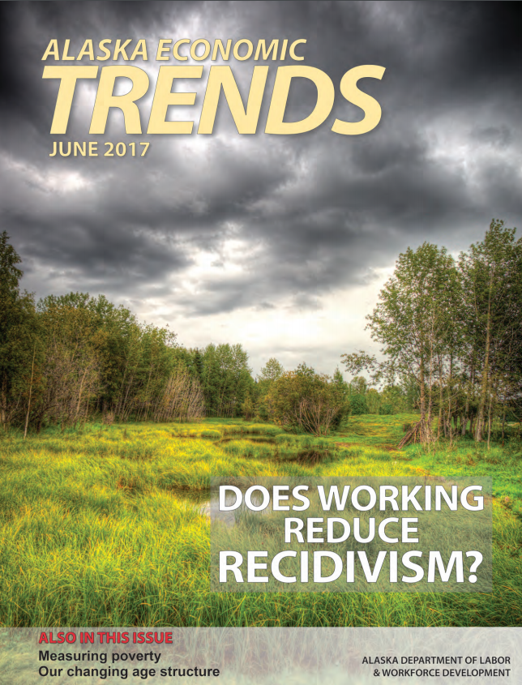
But it’s worth it
Notes:
Keep in mind that oil and gas jobs pay an average of around $120,000 a year so those losses alone equate to about $3.5 billion gone from our economy. On the other hand, somewhere around 30 percent of oil and gas workers are nonresidents and to the extent they were fly-in, fly-out workers to the North Slope, not much of those salaries were being spent in Alaska in the first place.

Slide 7
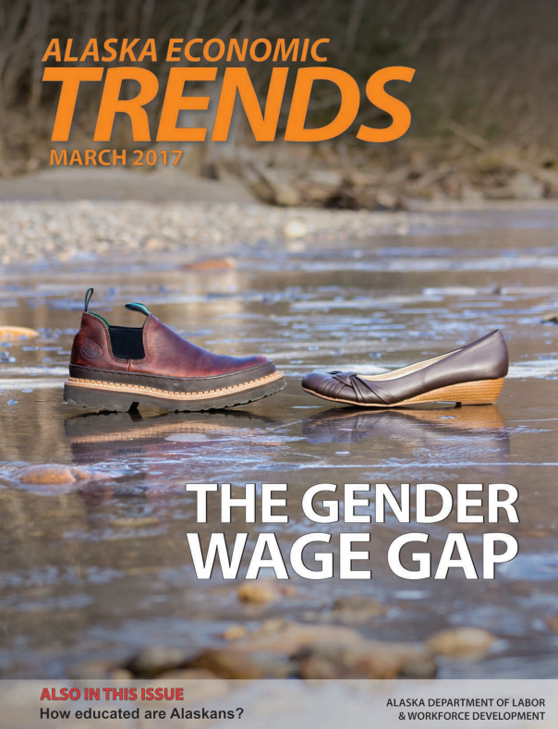
But it’s worth it
Notes:
Keep in mind that oil and gas jobs pay an average of around $120,000 a year so those losses alone equate to about $3.5 billion gone from our economy. On the other hand, somewhere around 30 percent of oil and gas workers are nonresidents and to the extent they were fly-in, fly-out workers to the North Slope, not much of those salaries were being spent in Alaska in the first place.

Slide 8

But it’s worth it
Notes:
Keep in mind that oil and gas jobs pay an average of around $120,000 a year so those losses alone equate to about $3.5 billion gone from our economy. On the other hand, somewhere around 30 percent of oil and gas workers are nonresidents and to the extent they were fly-in, fly-out workers to the North Slope, not much of those salaries were being spent in Alaska in the first place.

Slide 9

But it’s worth it
Notes:
Keep in mind that oil and gas jobs pay an average of around $120,000 a year so those losses alone equate to about $3.5 billion gone from our economy. On the other hand, somewhere around 30 percent of oil and gas workers are nonresidents and to the extent they were fly-in, fly-out workers to the North Slope, not much of those salaries were being spent in Alaska in the first place.

Slide 10
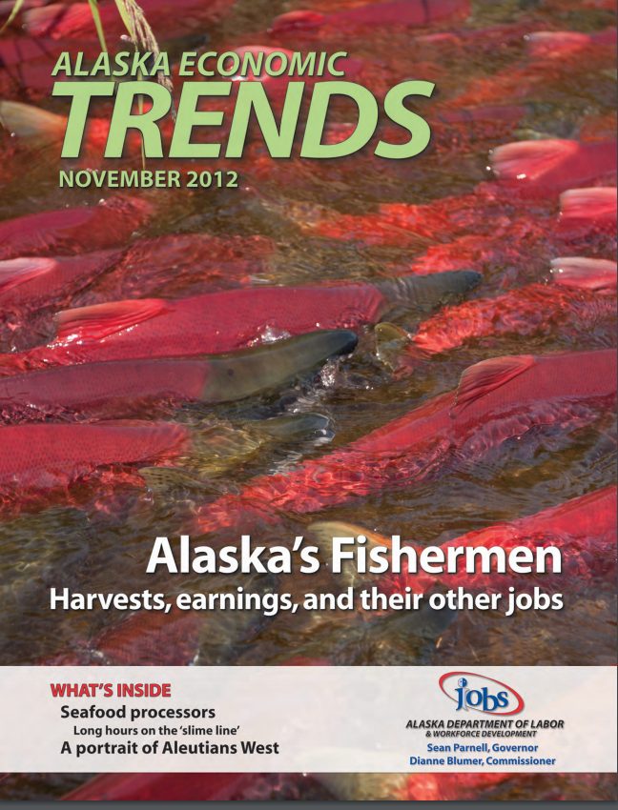
But it’s worth it
Notes:
Keep in mind that oil and gas jobs pay an average of around $120,000 a year so those losses alone equate to about $3.5 billion gone from our economy. On the other hand, somewhere around 30 percent of oil and gas workers are nonresidents and to the extent they were fly-in, fly-out workers to the North Slope, not much of those salaries were being spent in Alaska in the first place.

Slide 11
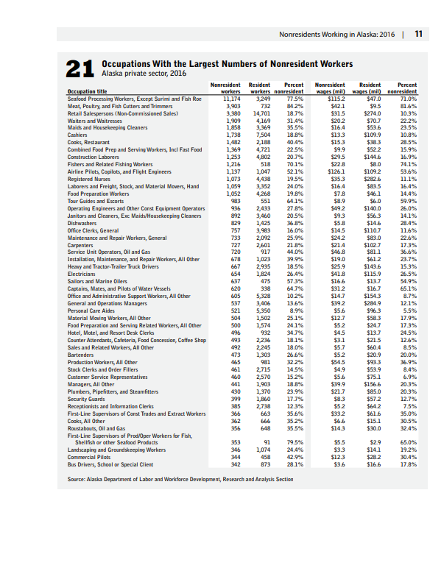
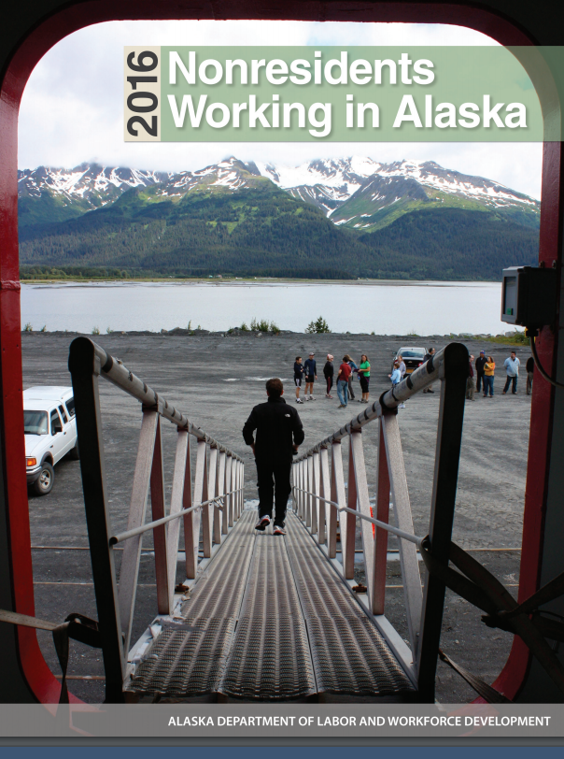
But it’s worth it
Notes:
Keep in mind that oil and gas jobs pay an average of around $120,000 a year so those losses alone equate to about $3.5 billion gone from our economy. On the other hand, somewhere around 30 percent of oil and gas workers are nonresidents and to the extent they were fly-in, fly-out workers to the North Slope, not much of those salaries were being spent in Alaska in the first place.

Slide 12
Suggestion: identify a single product for which there’d be strong demand
As opposed to thinking about all the things researchers could do if only they had …(fill in the blank: occupations, hours, etc.).
Saying “it would be a powerful new research tool” is true, but it’s not going to convince politicians or most administrators.
Possibilities?
Notes:
Keep in mind that oil and gas jobs pay an average of around $120,000 a year so those losses alone equate to about $3.5 billion gone from our economy. On the other hand, somewhere around 30 percent of oil and gas workers are nonresidents and to the extent they were fly-in, fly-out workers to the North Slope, not much of those salaries were being spent in Alaska in the first place.

